Slide 1
Welcome to Javascript

Slide 2
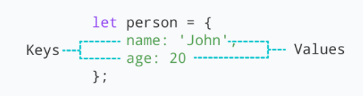
Object
JavaScript object is a non-primitive data-type that allows you to store multiple collections of data
Syntax:
const object_name = {
key1: value1,
key2: value2
}
// object creation
let person = {
name: 'John',
age: 20
};
console.log(typeof person); // object
"key: value" pairs are called properties

Slide 3
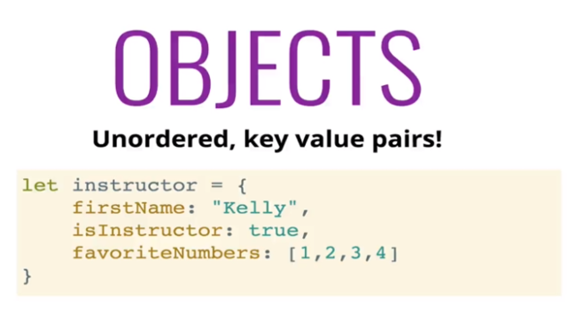
What is object

Slide 4
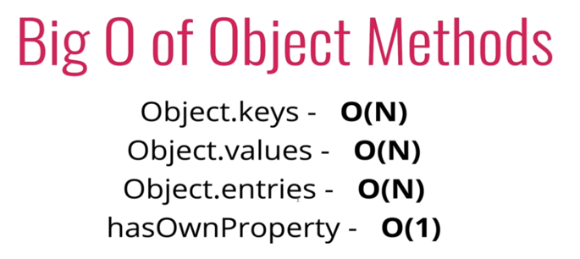
Time and space complexity

Slide 5
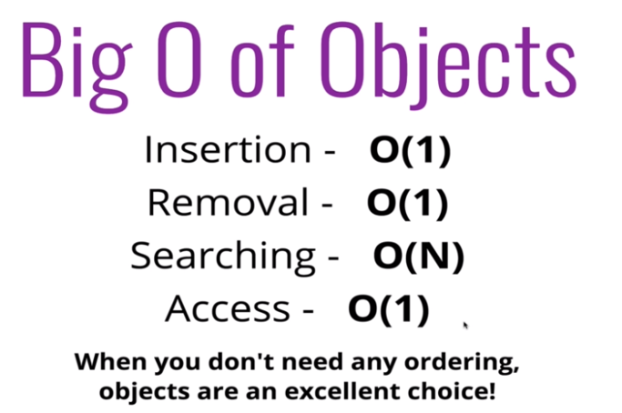
When to use it?

Slide 6
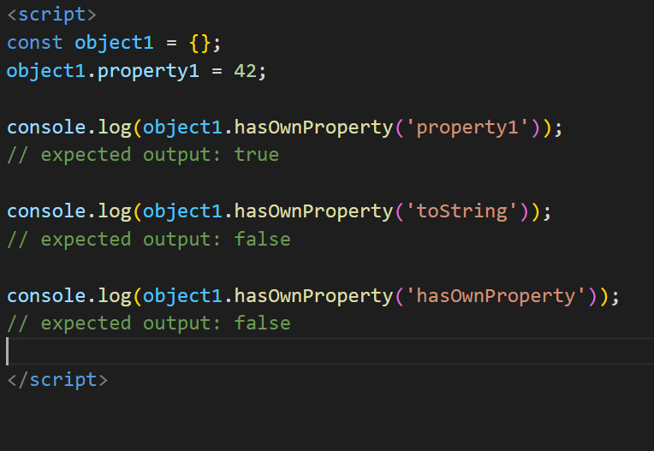
Object
Accessing Object Properties:
Syntax:
objectName.key
Or
objectName["propertyName"]
const person = {
name: 'John',
age: 20,
};
// accessing property
console.log(person.name); // John
const person = {
name: 'John',
age: 20,
};
// accessing property
console.log(person["name"]); // John

Slide 7
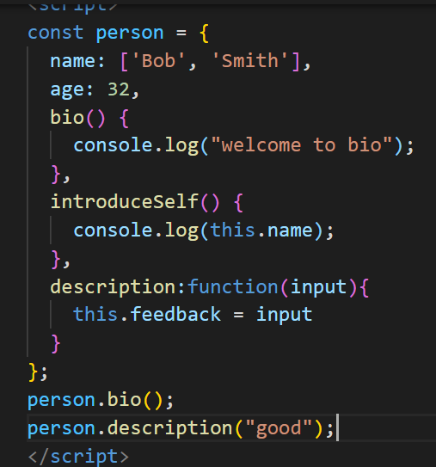
Writing Method inside the object

Slide 8
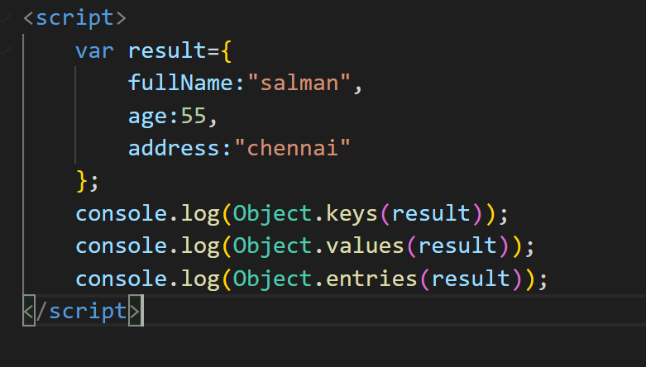
Object – for…in
Loop through an object Using for...in
const student = {
name: 'John',
age: 20,
hobbies: ['reading', 'games', 'coding'],
};
// using for...in
for (let key in student) {
let value;
// get the value
value = student[key];
console.log(key + " - " + value);
}

